Slide 1
Module 6
INTRODUCTION TO PHP

Slide 2
1. Origins and Uses of PHP
PHP was developed in 1994.
Originally, PHP was an acronym for Personal Home Page.
Later, its user community began using the recursive name PHP: Hypertext Preprocessor.
Today, PHP is developed, distributed, and supported as an open-source product.
A PHP processor is now resident on most Web servers.
The first version of PHP version 1.0 was released in 1995
The latest version of PHP is version 7.1.14 and 7.2.2 released in 1st February 2018

Slide 3
PHP - a server-side scripting language
used for form handling and database access.
it has driver support for 15 different database systems.
PHP supports the common electronic mail protocols POP3 and IMAP
It also supports the distributed object architectures COM and CORBA.

Slide 4
2. Overview of PHP
PHP is a server-side HTML- or XHTML-embedded scripting language.
it is an alternative to Microsoft’s Active Server Pages and Sun’s Java Server Pages.
When a browser requests a document that includes PHP script, the Web server that provides the document calls its PHP processor.
The server determines that a document includes PHP script by the file-name extension- .php, .php3, or .phtml

Slide 5
The PHP processor has two modes of operation: copy mode and interpret mode.
It takes a PHP document file as input and produces an HTML or XHTML document file.
When the PHP processor finds markup code in the input file- it simply copies it to the output file.
When the processor encounters PHP script in the input file- it interprets it and sends any output of the script to the output file.
The output file is sent to the requesting browser

Slide 6
PHP is usually purely interpreted
recent PHP implementations perform some precompilation, at least on complex scripts, which increases the speed of interpretation.
syntax and semantics of PHP are closely related to the syntax and semantics of JavaScript
PHP uses dynamic typing
PHP supports both procedural and object-oriented programming.
PHP has an extensive library of functions
PHP are free and easily obtainable , open-source system, available on all common computing platforms.

Slide 7
3. General Syntactic Characteristics
PHP scripts either are embedded in HTML or XHTML documents or are in files that are referenced by such documents
PHP code is embedded in documents by enclosing it between the <?php and ?> tags.
If a PHP script is stored in a different file-it is attached into the document using include construct which takes the filename as its parameter
include(“filename”);

Slide 8
All variable names in PHP begin with a dollar sign ($).
a letter or an underscore followed by any number (including zero) of letters, digits, or underscores.
PHP allows comments to be specified in three different ways # and // are single line comments and /* and */ are multiple line comments
PHP statements are terminated with semicolons (;)
Braces are used to form compound statements for control structures
PHP variable names are case sensitive.
The reserve words and function names in PHP are not case sensitive

Slide 9
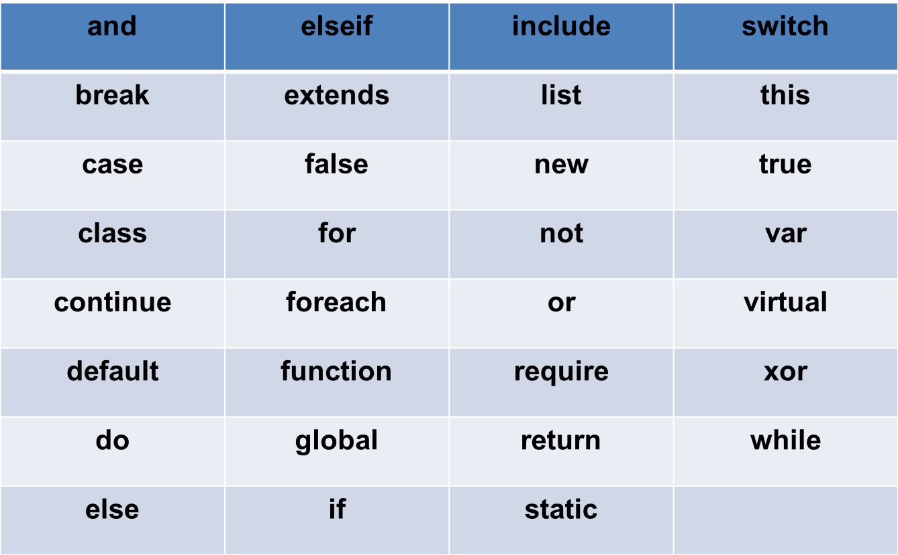
The following are the PHP reserved words

Slide 10
4. Primitives, Operations, and Expressions
PHP has four scalar types—Boolean, integer, double, and string
two compound types —array and object
two special types —resource and NULL

Slide 11
4.1 Variables
PHP is dynamically typed
type of a variable is set every time the variable is assigned a value.
unassigned variable(unbound variable)- has the value NULL
A variable can be tested to determine if it currently has a value using the IsSet function that takes a variable name as its parameter and returns a Boolean value
eg. The IsSet($fruit) returns TRUE if $fruit currently has a non-NULL value and FALSE otherwise

Slide 12
A variable can be set back to the unassigned state using unset function
Integer Type- PHP has a single integer type, named integer.
Double Type-
PHP’s double type corresponds to the double type of C
Double literals can include a decimal point, an exponent, or both
String Type
Characters in PHP are single bytes
There is no character type- A single character data value is represented as a string of length 1

Slide 13
String literals are defined with either single-quote (‘) or double-quote (“) delimiters.
In single-quoted string literals- escape sequences are not recognized
In double-quoted string literals, escape sequences are recognized and embedded variables are replaced by their current values.
$sum = 10.2
“The sum is : $sum”
produces The sum is : 10.2

Slide 14
Boolean Type-
only two possible values for the Boolean type are TRUE and FALSE
integer expression is used in a Boolean context:
it evaluates to FALSE if it is zero
otherwise, it is TRUE
If a string expression is used in a Boolean context,
it evaluates to FALSE if it is either the empty string or the string “0”
otherwise, it is TRUE

Slide 15
4.2. Arithmetic Operators and Expressions
PHP has the usual collections of arithmetic operators +, -, *, /, %, ++ and -- with the usual meaning
If both operands are integers the result produced is also integer
If either of the operand is a double the result produced is double
In integer division even if both operands are integers the result produced can be double

Slide 16
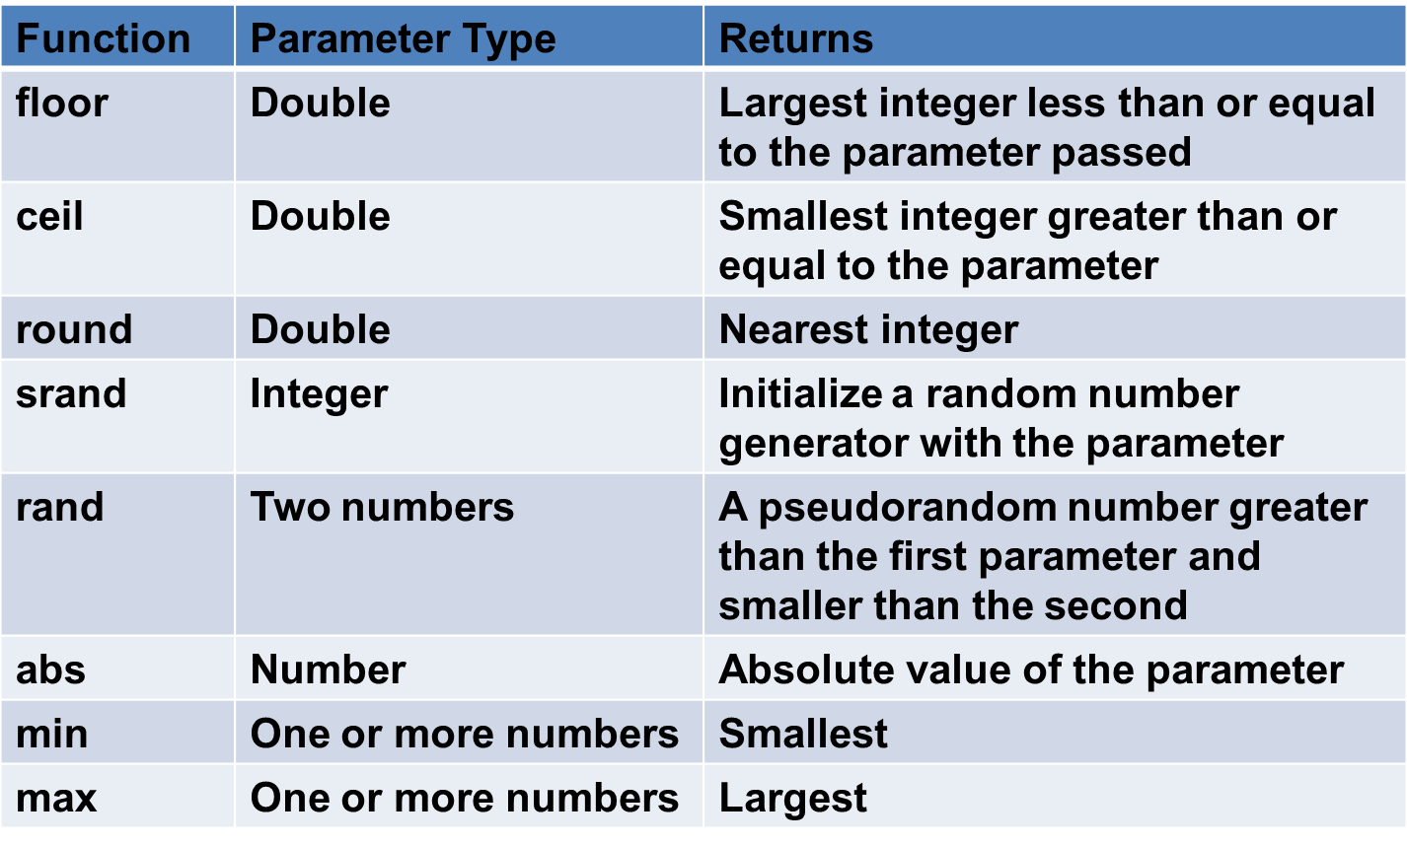
Predefined functions that operate on numeric values

Slide 17
4.3 String Operations
The only string operator is the catenation operator
specified with a period (.)
String variables are treated like arrays to access individual characters
The position of character starts with zero
The position of a character in a string can be specified in braces immediately after the variable’s name.
eg. If $str has the value “apple” then $str{4} is e

Slide 18
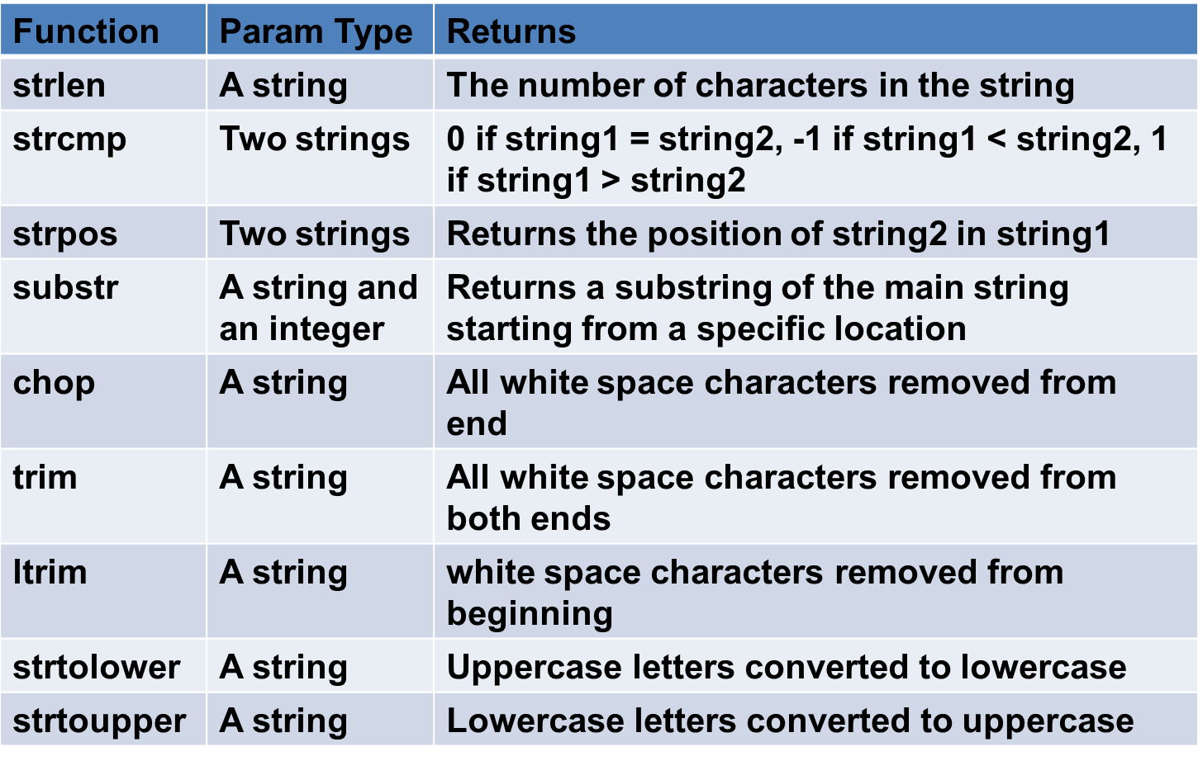
Commonly used string functions

Slide 19
4.4 Scalar Type Conversions
PHP has both implicit and explicit type conversions
Implicit type conversions are called coercions
If a numeric value appears in a string context the numeric value is coerced to a string
If a string value appears in a numeric context the string value is coerced to a numeric value
If a double is converted to an integer the fractional part is dropped and rounding is not done
Explicit type conversions can be done using predefined functions

Slide 20
4.5 Assignment Operators
PHP has the same set of assignment operators as its predecessor language, C, including the compound assignment operators such as += and /=.

Slide 21
5. Output
The print function is used to create output in PHP
The print can be called with or without parentheses around its parameters
Instead of a string parameter if some other type of value is given the PHP interpreter will coerce it to a string
eg: print(47) will produce 47
PHP also has the echo function, which is similar to print.
PHP also has the printf function which is borrowed from C
The general format of printf is
printf(literal_string, param1, param2, …)
The literal string can include labeling information about the parameters whose values are to be displayed.

Slide 22
It also contains format codes for those values.
The format code uses a percent sign (%) followed by the field width and a type specifier.
The common type specifiers are
s for strings,
d for integers and
f for floats and doubles
%10s—a character string field of 10 characters
%6d—an integer field of six digits
%5.2f—a float or double field of eight spaces, with two digits to the right of the decimal point, the decimal point, and five digits to the left

Slide 23
A PHP program to display date
<?xml version = "1.0" encoding = "utf-8"?>
<!DOCTYPE html PUBLIC "-//W3C//DTD XHTML 1.1//EN"
"http://www.w3.org/TR/xhtml11/DTD/xhtml11.dtd">
<html xmlns="http://www.w3.org/1999/xhtml">
<head>
<title>today.php</title>
</head>
<body>
<p>
<?php
print "<b>Welcome to my home page <br /> <br />";
print "Today is :</b>";
print date(“l, F jS");
print "<br />";
?>
</p>
</body>
</html>

Slide 24
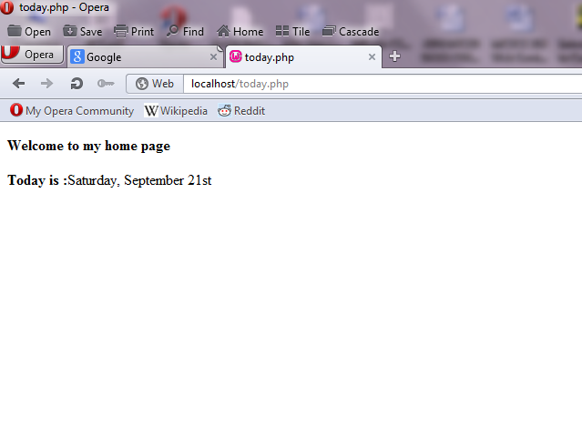
The Output of the program

Slide 25
6. Control Statements
The control statements of PHP are similar to those of C
6.1 Relational Operators
PHP uses the eight relational operators of JavaScript
The usual six ( >, <, >=, <=, !=, and == )
PHP also has ===, which produces TRUE only if both operands are the same type and have the same value,
and !==, the opposite of ===.

Slide 26
6.2 Boolean Operators
six Boolean operators: and, or, xor, !, &&, and ||.
The and and && operators perform the same operation, as do or and ||.
The difference between them is that the precedence of and and or is lower than that of && and ||.
6.3 Selection Statements
if statement
PHP’s if statement is like that of C.
The control expression can be an expression of any type, but its value is coerced to Boolean.
controlled statement segment can be either a single statement or a compound statement.
An if statement can include any number of elseif clauses

Slide 27
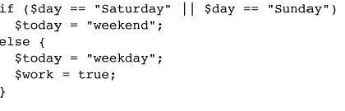

Slide 28
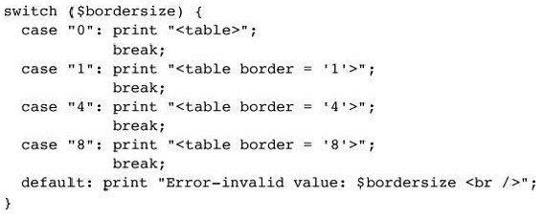
switch statement
has the form and semantics of that of JavaScript.

Slide 29
6.4 Loop Statements
The while, for, and do-while statements of PHP are exactly like those of JavaScript.
PHP also has a foreach statement
The break statement can be used to terminate the execution of a for, foreach, while, or do-while construct.
The continue statement is used in loop constructs to skip the remainder of the current iteration but continue execution at the beginning of the next.

Slide 30
A PHP program to display Powers table
<?xml version = "1.0" encoding = "utf-8"?>
<!DOCTYPE html PUBLIC "-//W3C//DTD XHTML 1.1//EN"
"http://www.w3.org/TR/xhtml11/DTD/xhtml11.dtd">
<html xmlns="http://www.w3.org/1999/xhtml">
<head>
<title>powers.php</title>
</head>
<body>
<table border = "border">
<caption> Powers table </caption>
<tr>
<th>Number </th>

Slide 31
<th>Square Root </th>
<th>Square </th>
<th>Cube </th>
<th>Quad </th>
</tr>
<?php
for ($number = 1; $number <= 10; $number++)
{
$root = sqrt($number);
$square = pow($number,2);
$cube = pow($number,3);
$quad = pow($number,4);
print ("<tr align = 'center'> <td> $number </td>");

Slide 32
print ("<td> $root </td> <td> $square </td>");
print ("<td> $cube </td> <td> $quad </td> </tr>");
}
?>
</table>
</body>
</html>

Slide 33
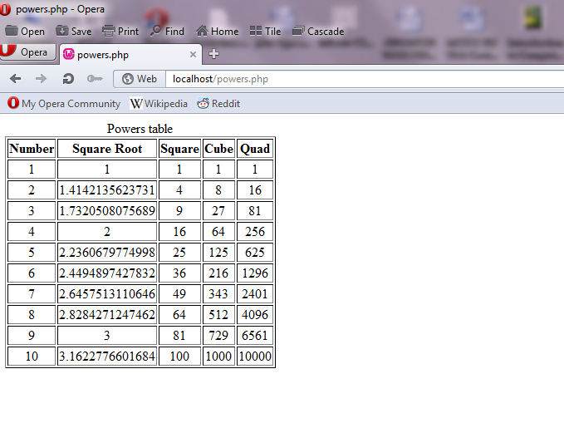
The Output of the program

Slide 34
7 Arrays
Arrays in PHP are unlike other common programming language
PHP arrays are combination of the arrays of a typical language and associative arrays, or hashes
Each array element consists of two parts: a key and a value.
If the array has a logical structure that is similar to an array in another language
- the keys are nonnegative integers and are always in ascending order
If the array has a logical structure that is similar to a hash
keys are strings and the order of its elements is determined with a system-designed hashing function.
the elements of an array need not be of the same type.

Slide 35
7.1 Array Creation
There are two ways to create an array in PHP:
Assigning a value to a subscripted variable creates the array.
$list[0] = 17;
If empty brackets are used in an assignment to an array, a numeric subscript is implicitly furnished.
the furnished subscript is 1 greater than the largest used so far in the array
$list[1] = “Today is my birthday!”;
$list[] = 42;
the second element’s subscript will be 2

Slide 36
The second way to create an array is with the array construct.
The parameters of array specify the values to be placed in a new array and sometimes also the keys.
$list = array(17, 24, 45, 91);
creates a traditional array of four elements, with the keys 0, 1, 2, and 3.
$list = array(1 => 17, 2 => 24, 3 => 42, 4 => 91);
An array construct with empty parentheses creates an empty array.
$list = array();
The following statement creates an array that has the form of a hash:
$ages = array(“Joe” => 42, “Mary” => 41, “Bif” => 17);

Slide 37

7.2 Accessing Array Elements
Individual array elements can be accessed by subscripting, as in other programming languages.
The value in the subscript, which is enclosed in brackets, is the key of the value being referenced.
$ages[‘Mary’] = 29;
The list construct can be used to assign multiple elements of an array to scalar variables in one statement.

Slide 38

7.3 Functions for Dealing with Arrays
A whole array can be deleted with unset
Individual elements of an array also can be removed with unset $list = array(2, 4, 6, 8);
unset($list[2]);
The array_keys function takes an array as its parameter and returns an array of the keys of the given array.
The array_values function does for values what array_keys does for keys.
the value of $days to (“Mon“, “Tue“, “Wed“, “Thu“, “Fri“) and the value of $temps to (74, 70, 67, 62, 65).

Slide 39
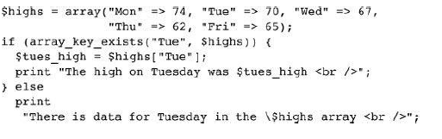
The existence of an element of a specific key can be determined with the array_key_exists function, which returns a Boolean value.

Slide 40
The is_array function takes a variable as its parameter and returns TRUE if the variable is an array, FALSE otherwise
The in_array function takes two parameters—an expression and an array—and returns TRUE if the value of the expression is a value in the array; otherwise, it returns FALSE.
The number of elements in an array can be determined with the sizeof function.

Slide 41

The explode function explodes a string into substrings and returns them in an array.
The delimiters of the substrings are defined by the first parameter of explode which is a string;
the second parameter is the string to be converted.

Slide 42
The implode function it catenates the elements of the array together, using the given separator string between the elements, and returns the result as a string.

Slide 43
Internally the elements of an array are stored in a linked list of cells where each cell includes both the key and the value of the element
The cells are stored in memory through a key hashing function so that they are randomly distributed in a reserved block of storage
Access to elements through string keys are implemented through the hashing function
The elements have links that connect them in the order in which they were created which allows them to be accessed in that order.

Slide 44
Logical internal structure of arrays
This shows how two different access methods can be supported
SequentialAccess Functions
Key Value Next
Current
Key-Based Access Functions
Hash Function
Key Value Next
Key Value Next

Slide 45
7.4 Sequential Access to Array Elements
Every array has an internal pointer that refers to one element of the array called the current pointer
The pointer is initialized to reference the first element of the array at the time the array is created
The element being referenced by the pointer can be obtained with the current function
$cities = array (“Delhi ”, “Mumbai”, “Kolkata”, Chennai”);
$city = current($cities);
print (“The first city is $city <br/>”);
produces The first city is Delhi
The current pointer can be moved with the next function that moves the pointer to the next array element and returns the value

Slide 46
If the current pointer points to the last element of the array then next returns FALSE
The following code produces the list of all cities in the array
$city = current($cities);
print(“$city <br/>”);
while ($city = next($cities))
print(“$city <br/>”);
The each function can return a two element array consisting of the key and the value of the current element
The keys of the two elements of the return value from each are the strings “keys” and “value”
The current pointer can be moved backward with the prev function
The prev function returns the value of the element referenced by the current pointer after the pointer has been moved

Slide 47
The current pointer can be set to the first element with the reset function which also returns the value of the first element
It can be set to the last element of the array with the end function which also returns the value of the last element
The key function when given the name of an array returns the key of the current element of the array
The array_push and array_pop functions provide a simple way to implement a stack in an array

Slide 48
The foreach statement is designed to build loops that process all of the elements of an array
The foreach statement has two forms and they are
foreach (array as scalar_variable) loop body
foreach (array as key => value) loop body

Slide 49
Sorting Arrays
The sort function sorts an array with string values followed by numeric values in ascending order if the array contains both string values and numeric values
The asort function is used to sort arrays that correspond to hashes
It sorts the elements of a given array by their values but keeps the original key-value associations
The elements will be sorted in ascending order where strings followed by numeric values
The ksort function sorts the given array by keys rather than values
The key-value association is maintained in the process
The rsort, arsort and krsort functions sort elements in the descending order like their counterparts sort, asort and ksort

Slide 50
8. Functions
PHP supports user-defined functions
8.1 General Characteristics of Functions
The general form of a PHP function definition:
function name([parameters]) {
...
}
The square bracket around the parameters means they are optional
In PHP the function definition does not need to appear in a document before the function is called
Function overloading is not allowed in PHP
Function names are not case sensitive
The return statement is used to return a value from a function and will be the last statement in a function

Slide 51
If one or more related functions are used by more than one document- store their definitions in a separate file and copy that file into those documents when they are requested by a client (browser).
This is done with the include function.
8.2 Parameters
parameters in the call to a function actual parameters.
parameters that are listed in the function definition formal parameters.

Slide 52
9 Pattern Matching
The preg_match is a function in PHP for pattern matching
The preg_match function takes two parameters the first is the regular expression as a string and the second parameter is the string to be searched
The preg_split function operates on strings and returns an array
The preg_split function takes two parameters the first is a pattern as a string and the second parameter is the string to be split
eg. $fruit_string = “apple : orange : banana”;
$fruits = preg_split(“/ : /”, $fruit_string);
then the array $fruits has now (“apple”, “orange”, “banana”)

Slide 53
10 Form Handling
PHP can be used for Form Handling
The PHP script is embedded in an XHTML document
A form is used to collect information from the user
PHP can be configured so that form data values are directly available as implicit variables whose names match the names of the corresponding form elements
PHP uses implicit arrays for form values $_POST and $_GET
These arrays have keys that match the form element names and values that were input by the client
eg. If a form has a text box named street and the form method is POST the value of that element is available in the PHP script as $_POST[“street”]

Slide 54
11. Cookies
A session is the time span during which a browser interacts with a particular server.
Cookies provide a general approach to storing information about sessions on the browser system itself.
The server is given this information when the browser makes subsequent requests for resources from the server.

Slide 55
A cookie is a small object of information that includes a name and a textual value.
A cookie is created by some software system on the server
The header part of an HTTP communication include cookies
At the time it is created, a cookie is assigned a lifetime.
When the cookie reaches its lifetime, the cookie is deleted from the browser’s host machine.

Slide 56
11.1 PHP Support for Cookies
A cookie is set in PHP with the setcookie function.
This function takes one or more parameters
The first parameter, which is mandatory, is the cookie’s name given as a string.
The second, if present, is the new value for the cookie, also a string.
The third parameter, when present, is the expiration time in seconds for the cookie, given as an integer.
The default value for the expiration time is zero- the cookie is destroyed at the end of the current session.
setcookie(“voted”, “true”, time() + 86400);
The time function returns the current time in seconds.

Slide 57
A cookie should be created before any other XHTML tag is executed
In PHP all cookies that arrive with a request are placed in the implicit $_COOKIES array which has the cookie name as the key and the cookie value as value.

Slide 58
12. Session Tracking
session arrays store a unique session ID for a session.
session arrays are stored on the server.
a session ID is an internal value that identifies the session.
In PHP a session_start function is used to start a session which causes a session ID to be created and recorded
the $_SESSION array which stores any session variables and their values that was registered in the previous session
Session key/value pairs are created or changed by assignments to the $_SESSION array
The session details can be destroyed with the unset operator

